Slide 1

Shamir’s Secret Encryption Breaking
Pardha Saradhi Pamarthi - 11648100
Eeshwar Reddy Kotha - 11641212
Litwin Poddoku - 11656602
Hemanth Kumar Munagala - 11637925

Slide 2
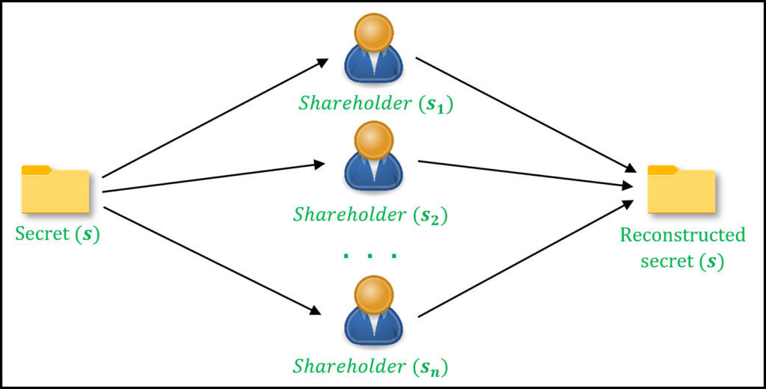
Introduction
Unravel the complexities of Shamir’s Secret Encryption, a unique cryptographic scheme, for deeper understanding.
Dissect and decipher encryption methods to reveal inner workings and vulnerabilities.
Comprehensively analyse the encryption process to identify strengths, weaknesses, and potential vulnerabilities.
Develop a decryption method to unlock messages without a secret key for enhanced security.
Enhance knowledge and understanding of Shamir’s Secret Encryption through meticulous examination.
Identify security holes to provide insights into practical implications and limitations.
Contribute to the advancement of cryptographic research and the development of robust encryption methods.
Notes:
The project aimed to dissect Shamir's Secret Encryption, deciphering its flaws and restrictions. Through meticulous analysis and model development, the team explored vulnerabilities and limitations within the encryption scheme. By implementing various cryptanalysis techniques and statistical analysis, the project sought to break the encryption and understand its security implications comprehensively. The development of decryption tools played a pivotal role in this endeavor, enabling the team to unravel the complexities of Shamir's Secret Encryption and assess its reliability in safeguarding sensitive information. The project contributed significantly to knowledge by shedding light on the vulnerabilities of Shamir's Secret Encryption and emphasizing the importance of robust decryption tools in comprehending the security risks associated with cryptographic systems, ultimately enhancing our understanding of encryption protocols and their practical implications.

Slide 3
Project elements
Encryption Scheme Analysis:
Examination of the provided source code to understand the encryption process and identify vulnerabilities.
Mathematical Model Development:
Creation of a mathematical representation of the encryption process, considering the impact of the randomly generated key.
Cryptanalysis Techniques:
Exploration of methods like statistical analysis and brute-force attacks to break Shamir's Secret Encryption and identify vulnerabilities.
Statistical Analysis:
Examination of encrypted messages for trends and vulnerabilities, alongside the creation of a brute-force strategy for decryption.
Decryption Tool:
Development and implementation of a tool leveraging analysis and mathematical models to decrypt messages encrypted with Shamir's Secret Encryption.
Notes:
By analyzing the code, we scrutinize its structure, logic, and functionality to understand how the encryption is performed. This involves studying how the polynomial is generated, how keys are utilized, and how encryption pairs are produced. Additionally, we identify essential elements of Shamir's Secret Encryption present in the code, such as polynomial generation, key generation, and encryption pair creation. Through this analysis, we aim to uncover any flaws or vulnerabilities in the implementation, such as potential weaknesses in the key generation process or vulnerabilities in the encryption algorithm. By identifying these weaknesses, we can better understand the security implications of the encryption scheme and devise strategies to improve its robustness.

Slide 4
Encryption scheme analysis
Polynomial Generation:
A polynomial is created with random coefficients, consisting of a message coefficient followed by 31 additional random coefficients.
These coefficients are used to construct the polynomial, representing the encryption scheme.
Key Utilization:
Keys are utilized to determine whether each encryption pair is "real" or "fake."
A randomly generated key is used to iterate through each bit position (64 bits) to determine whether to create a real or fake pair.
If a bit in the key is set, a real pair is generated using the polynomial; otherwise, a fake pair is generated.
Encryption Pair Production:
For each bit position, if the corresponding bit in the key is set, a real pair is produced by evaluating the polynomial at a randomly chosen x-coordinate and storing the resulting (x, y) pair.
If the bit is not set, a fake pair is produced by generating two random values, x and y, and storing the (x, y) pair.
Notes:
the development of a mathematical model begins with the generation of a polynomial using random coefficients, including a message coefficient and additional random coefficients. This polynomial serves as the core representation of the encryption scheme. The randomly generated key dictates the creation of encryption pairs, determining whether each pair is "real" or "fake" based on the key's bits. The key's impact on both encryption and decryption processes is significant, as it controls which pairs are used in encryption and subsequently influences the decryption process. Additionally, Lagrange interpolation is employed to recover polynomial coefficients during decryption, allowing for the reconstruction of the original polynomial from encrypted pairs. This technique facilitates the decryption process by accurately reconstructing the polynomial and enabling the recovery of the encrypted message.

Slide 5
Model development
Mathematical model development initiates with polynomial generation using random coefficients.
The polynomial represents the core of the encryption scheme in the code.
Randomly generated key dictates creation of encryption pairs, distinguishing real from fake.
Key's influence extends to both encryption and decryption processes significantly.
Lagrange interpolation aids in polynomial coefficient recovery during decryption.
It enables accurate reconstruction of the original polynomial from encrypted pairs.
Lagrange interpolation facilitates decryption by enabling encrypted message recovery effectively.
Notes:
the development of a mathematical model begins with the generation of a polynomial using random coefficients, including a message coefficient and additional random coefficients. This polynomial serves as the core representation of the encryption scheme. The randomly generated key dictates the creation of encryption pairs, determining whether each pair is "real" or "fake" based on the key's bits. The key's impact on both encryption and decryption processes is significant, as it controls which pairs are used in encryption and subsequently influences the decryption process. Additionally, Lagrange interpolation is employed to recover polynomial coefficients during decryption, allowing for the reconstruction of the original polynomial from encrypted pairs. This technique facilitates the decryption process by accurately reconstructing the polynomial and enabling the recovery of the encrypted message.

Slide 6
Cryptanalysis techniques
Cryptanalysis methods explored to uncover vulnerabilities and enhance security.
Examination of implementation for weaknesses and potential side-channel attacks.
Identification of vulnerabilities crucial to understanding encryption scheme's security risks.
Addressing risks essential for ensuring robustness and reliability of encryption.
Thorough examination and analysis aim to develop strategies for risk mitigation.
Importance lies in safeguarding sensitive information and preventing unauthorized access.
Exploration of cryptanalysis methods pivotal for fortifying encryption against potential threats.
Notes:
In the exploration of cryptanalysis methods within the provided code, established techniques are examined to uncover potential vulnerabilities. This includes scrutinizing the implementation for weaknesses and potential side-channel attacks. By identifying vulnerabilities, the team can understand the security risks associated with the encryption scheme. Addressing these risks is crucial to ensure the robustness and reliability of the encryption process. Through thorough examination and analysis, the project aims to develop strategies to mitigate these risks and enhance the overall security of the system. The importance of this process lies in safeguarding sensitive information and preventing unauthorized access or decryption of encrypted messages. Thus, the exploration of cryptanalysis methods plays a pivotal role in fortifying the encryption scheme against potential threats and vulnerabilities.

Slide 7
Statistical analysis
Brute-force strategy systematically tests every possible key combination for decryption.
Viability assessed through rigorous testing to gauge effectiveness in breaking encryption.
Encrypted messages analysed for statistical trends and potential vulnerabilities to aid decryption.
Statistical analysis provides insights into distribution and characteristics of encrypted data.
Understanding statistical trends aids in developing targeted decryption approaches.
Statistical analysis improves overall success rate of decrypting messages effectively.
Statistical analysis serves as a valuable tool in enhancing decryption strategies.
Notes:
The creation of a brute-force strategy within the provided code involves systematically trying every possible key combination to decrypt the encrypted messages. This strategy's viability is evaluated through rigorous testing to determine its effectiveness and efficiency in breaking the encryption. Additionally, encrypted messages are examined for statistical trends and vulnerabilities, aiming to identify patterns or weaknesses that could aid in decryption. Statistical analysis plays a crucial role in decryption efforts by providing insights into the distribution and characteristics of encrypted data. Understanding these statistical trends can help in developing more targeted decryption approaches and improving the overall success rate of decrypting messages. Therefore, statistical analysis serves as a valuable tool in deciphering encrypted messages and enhancing the effectiveness of decryption strategies.

Slide 8
Decryption tool
Leveraging Analysis and Mathematical Models:
Utilizes previously developed models for decryption algorithm implementation.
Mathematical Model Utilization:
Reconstruction of polynomial using Lagrange interpolation from encrypted pairs.
Employment of Analysis Techniques:
Identifying vulnerabilities and patterns in encrypted messages to aid decryption process.
Rigorous Testing:
Ensuring accuracy and effectiveness of the decryption tool through comprehensive testing.
Verification of Reliability:
Ensuring the tool can decrypt messages encrypted with Shamir's Secret Encryption.
Scenario-Based Testing:
Evaluation of tool performance across different encryption scenarios for robustness.
Integration for Security:
Integration of analysis, mathematical models, and testing for secure message decryption.
Notes:
The decryption tool development and implementation involve leveraging analysis and mathematical models created earlier in the project. It utilizes the mathematical model to reconstruct the polynomial from encrypted pairs using Lagrange interpolation. The tool employs analysis techniques to identify vulnerabilities and patterns in encrypted messages, aiding in decryption. Through rigorous testing, the tool's accuracy and effectiveness are verified, ensuring its reliability in decrypting messages encrypted using Shamir's Secret Encryption. Testing involves using encrypted messages to evaluate the tool's performance under various scenarios, ensuring it can successfully decrypt messages without needing the secret key. By integrating analysis, mathematical models, and thorough testing, the decryption tool becomes a robust solution for breaking the encryption scheme and retrieving sensitive information securely.

Slide 9
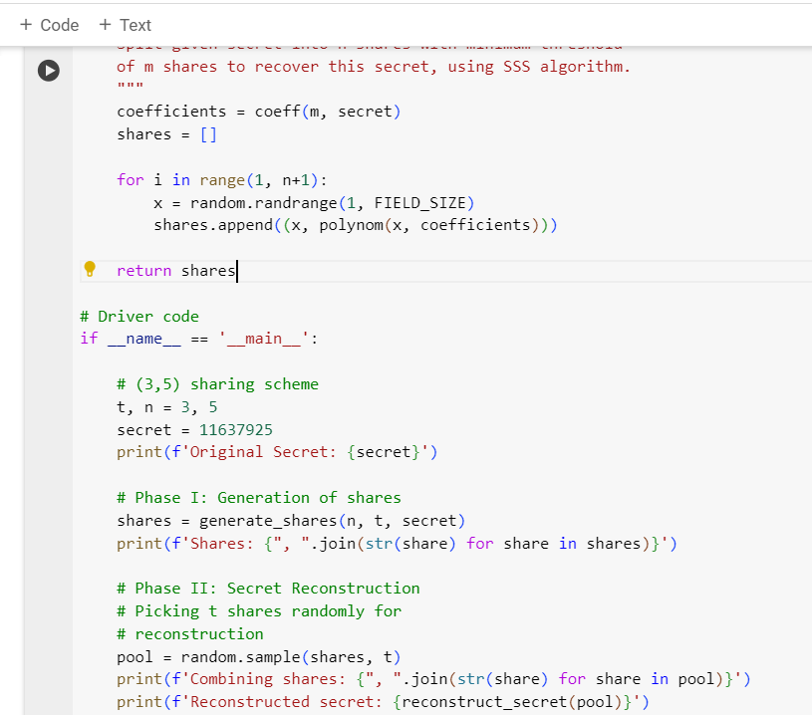

Slide 10
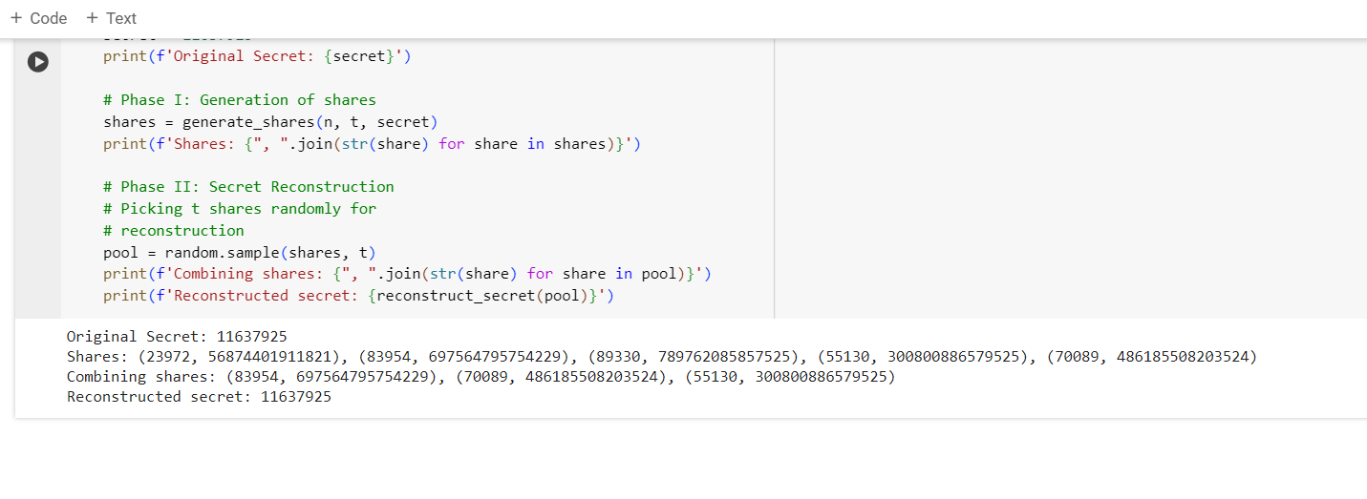

Slide 11

Conclusion
Project aimed to dissect Shamir's Secret Encryption, uncovering flaws and restrictions.
Meticulous analysis and model development explored encryption scheme vulnerabilities and limitations.
Implementation of cryptanalysis techniques sought to break the encryption comprehensively.
Development of decryption tools pivotal in understanding encryption complexities.
Project shed light on vulnerabilities, stressing importance of robust decryption tools.

Slide 12

Hack the Box – Challenge Completion Screenshot

Slide 13
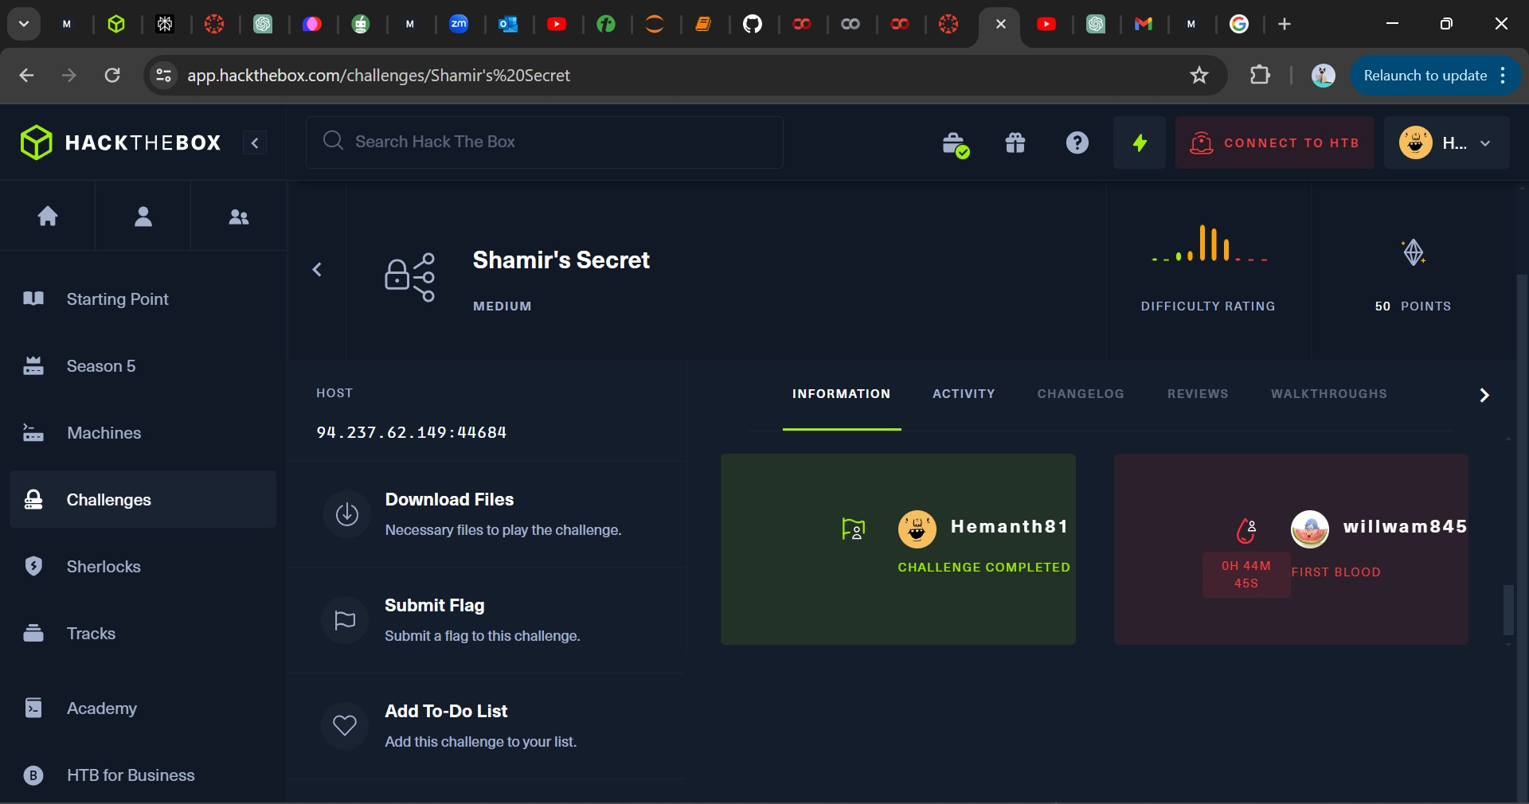

Slide 14


